Slide 1



Product Demand Forecasting
Model
Presented by Career Craaft

Slide 2

Problem statement
01.
Inaccuracy in Predictions– The manual forecasts often deviated significantly from actual sales due to human bias and lack of statistical rigor.
02.
Lack of Scalability – As FreshMart expanded into new locations and product categories, manual forecasting became increasingly unmanageable
Ignoring Seasonal Trends – Demand fluctuations due to seasonality, festivals, and promotional schemes were not effectively captured
03.
04.
Inventory Mismanagement – Inaccurate forecasts led to either overstocking, causing increased holding costs, or stockouts, resulting in lost sales opportunities.

Slide 3

Introduction
Product Demand Forecasting is the process of predicting future customer demand for a product or service over a specific time period. It leverages historical data, market trends, and statistical or machine learning models to estimate how much of a product will be needed, enabling businesses to optimize operations, reduce costs, and meet customer expectations.

Slide 4

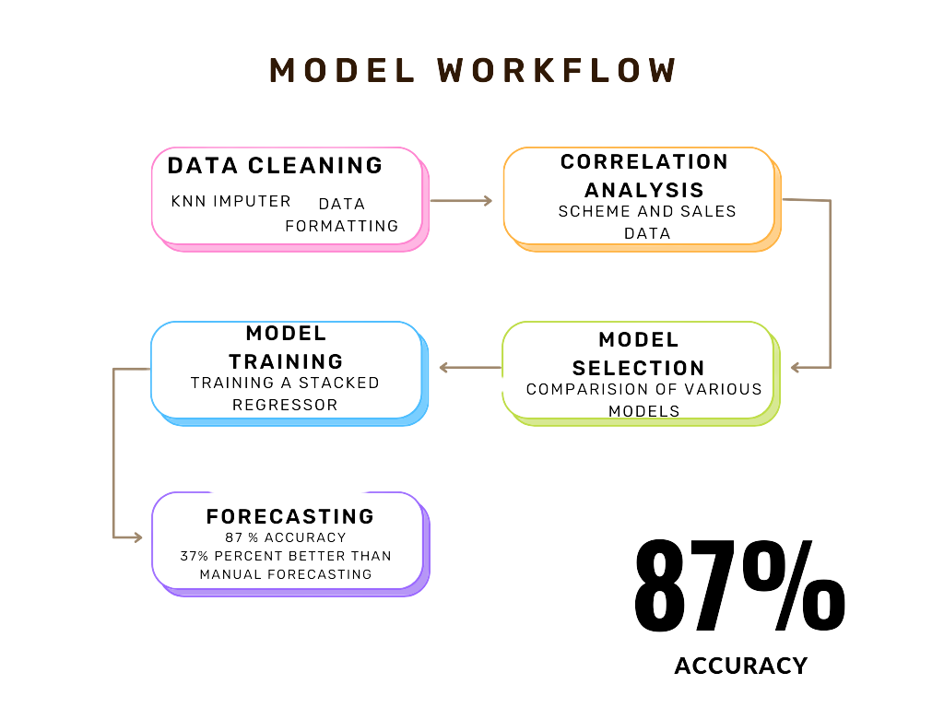

Slide 5
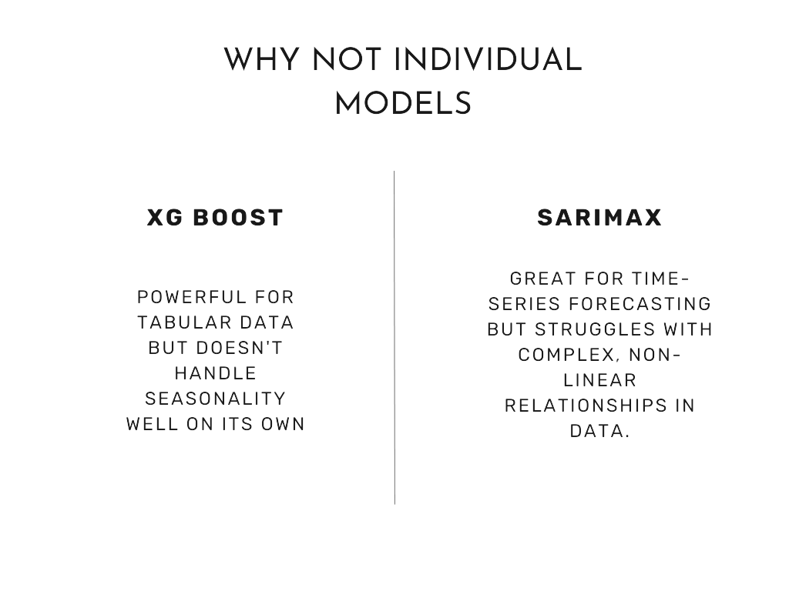
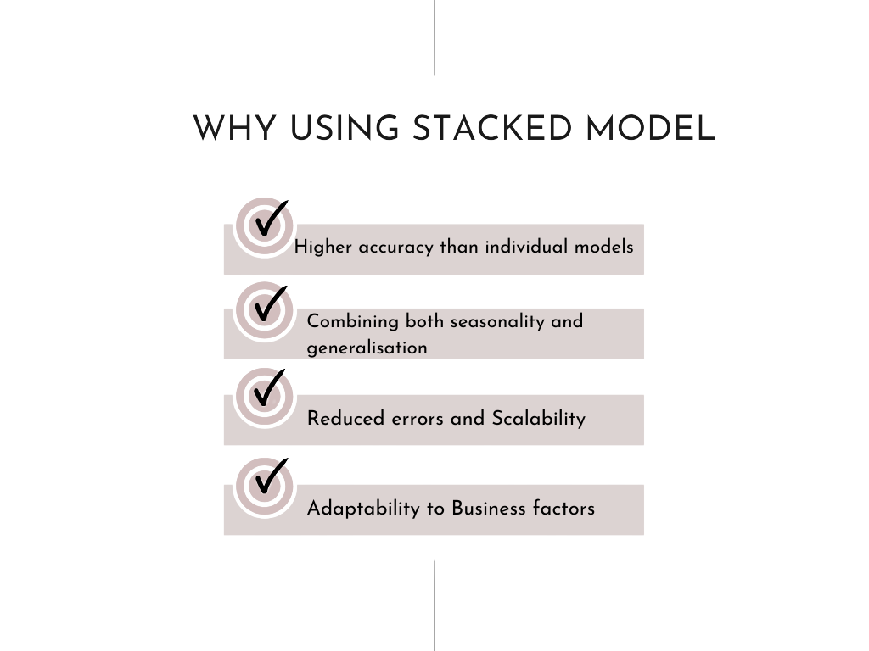

About Model

Slide 6

Methodology
We made a Machine learning model to solve Business problems like inaccuracies , scheme management, inventory mismanagement and to predict sales of multiple SKU’s.
We made an Stacked regressor model of XGBoost , Random Forest and LightGBM for our demand forecasting as it was a good option since these algorithms are designed to work with structured data, identify intricate patterns, and provide high accuracy.
XGBoost
Random Forest
LightGBM

Slide 7
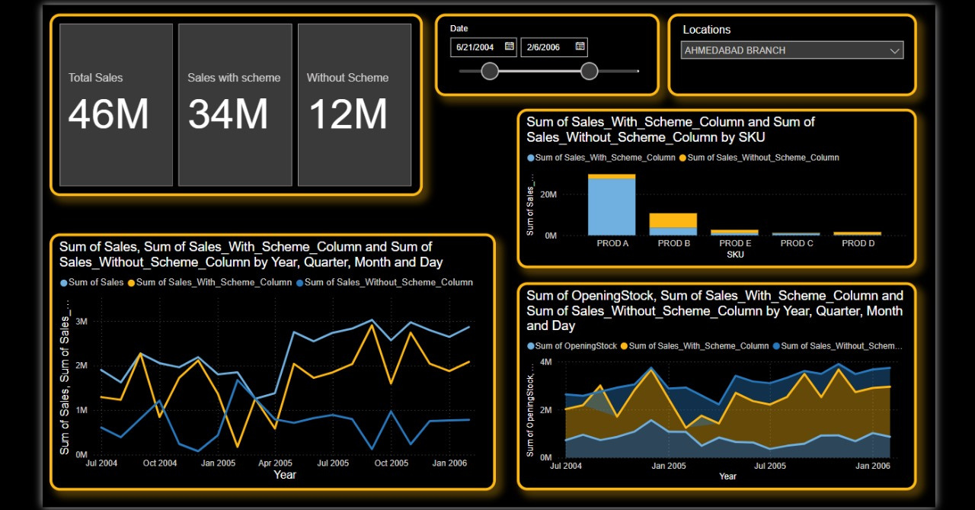
Visualization

Slide 8
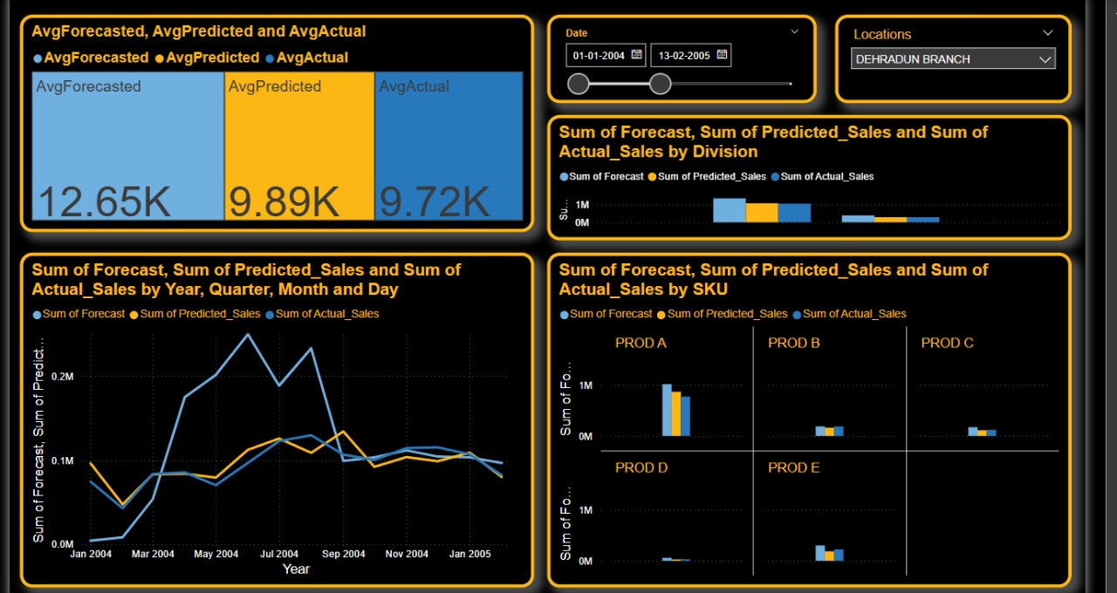

Slide 9

The Model
1.Model Architecture
Random Forest Regressor with 500 trees
Maximum depth of 20 levels
2.Input Parameters
Five critical air pollutants (PM2.5, PM10, NO2, CO, SO2)
StandardScaler for feature normalization
Real-time input validation and processing
3.Performance Metrics
Accuracy threshold within 10% of actual AQI values
Model trained on comprehensive dataset of Indian cities
87%

Slide 10
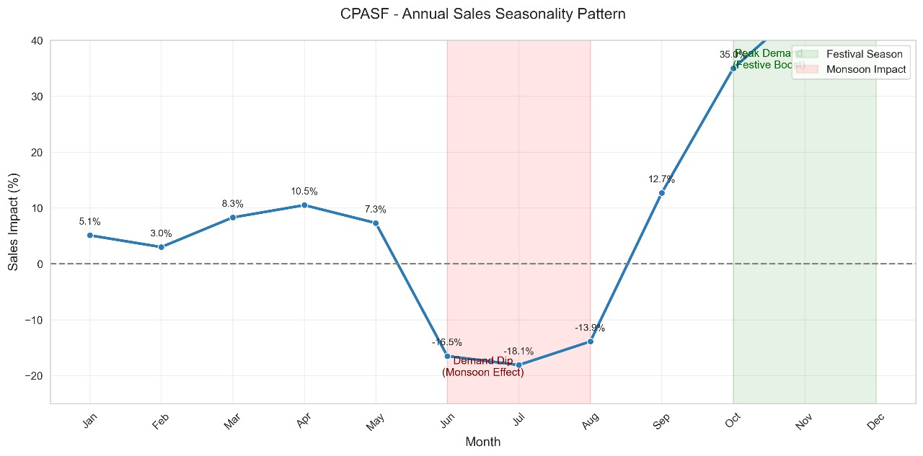

Slide 11
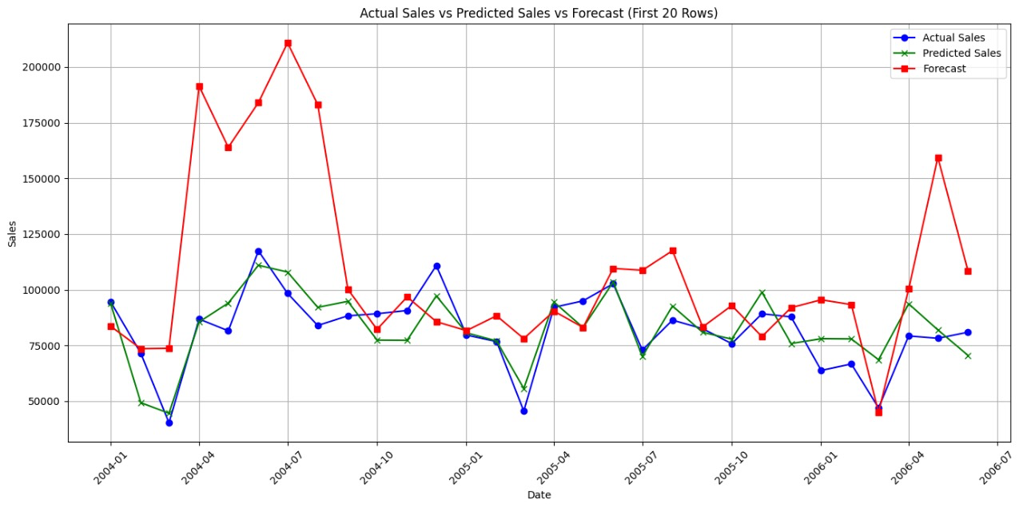

Slide 12



Technologies Used
Programming Language
Python 3.x
Machine Learning Libraries
scikit-learn (for Random Forest model)
NumPy (for numerical computations)
Pandas (for data manipulation)
Visualization Libraries
Plotly Express (for interactive graphs and charts)
Power BI
Development & Deployment
GitHub (version control)

Slide 13
Benefits of Our Solution
1.Reduces Errors and inaccuracies.
2.Saves Money
3.Performance Metrics
38.03% improvement over the values forecasted as per Mean Absolute Error (MAE).
35.38% improvement in Root Mean Squared Error (RMSE).
R square is 0.87 (Approx 87%)
Overall 36% better than manual procedure.

Slide 14
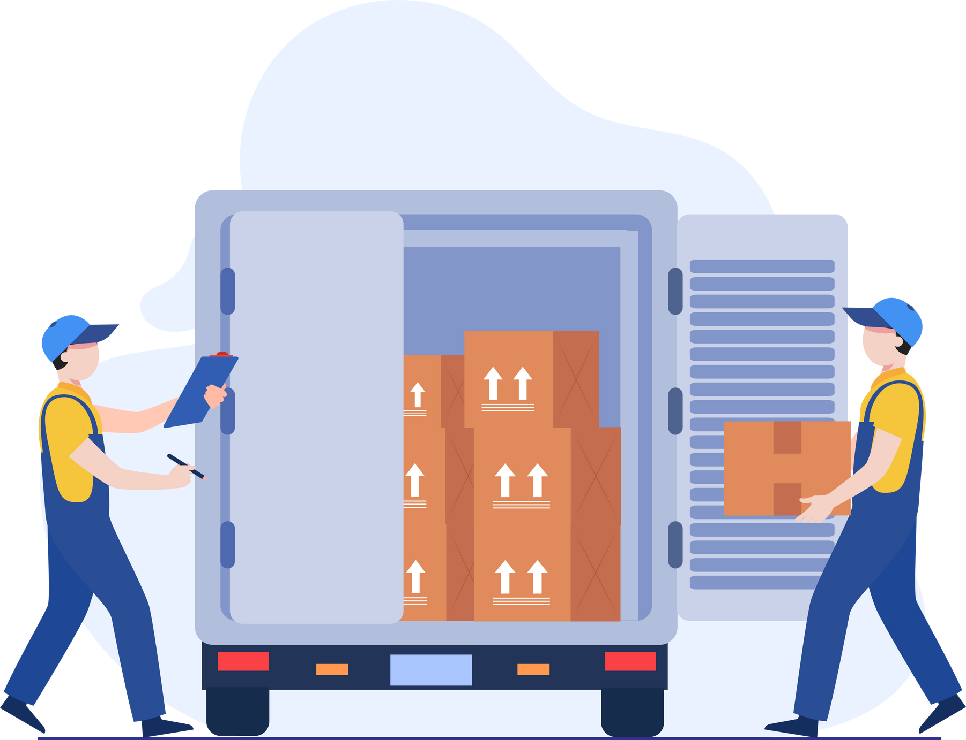
To demonstrate how your demand forecasting model saves money for FreshMart FMCG, let’s use the example
Cost of Overstocking: ₹10 per unit (storage cost for excess inventory).
Cost of Stockouts: ₹50 per unit (lost sales opportunity due to insufficient inventory).
Calculate Costs for Manual Forecasting
Let’s assume FreshMart uses manual forecasting and experiences the following:
Overstocking: 1,000 units per month.
Stockouts: 500 units per month.
Cost of Overstocking:
Formula: Overstocked Units × Cost per Unit
Calculation: 1,000 units × ₹10 = ₹10,000 per month.
Cost of Stockouts:
Formula: Stockout Units × Cost per Unit
Calculation: 500 units × ₹50 = ₹25,000 per month.
Total Cost for Manual Forecasting:
Formula: Cost of Overstocking + Cost of Stockouts
Annual Cost Savings:
Formula: Monthly Savings × 12

Slide 15

Calculation: ₹28,000 × 12 = ₹3,36,000 per year.
Calculation: ₹10,000 + ₹25,000 = ₹35,000 per month.
Overstocking: Reduced to 200 units per month.
Stockouts: Reduced to 100 units per month.
Cost of Overstocking:
Formula: Overstocked Units × Cost per Unit
Calculation: 200 units × ₹10 = ₹2,000 per month.
Cost of Stockouts:
Formula: Stockout Units × Cost per Unit
Calculation: 100 units × ₹50 = ₹5,000 per month.
Total Cost for Advanced Forecasting Model:
Formula: Cost of Overstocking + Cost of Stockouts
Calculation: ₹2,000 + ₹5,000 = ₹7,000 per month.
Formula: Total Cost (Manual) - Total Cost (Advanced Model)
Calculation: ₹35,000 - ₹7,000 = ₹28,000 per month.
Formula: Cost of Overstocking + Cost of Stockouts
Annual Cost Savings:
Formula: Monthly Savings × 12
Calculation: ₹28,000 × 12 = ₹3,36,000 per year.

Slide 16

Thank you!
Presented by Career Craaft

